Slide 1
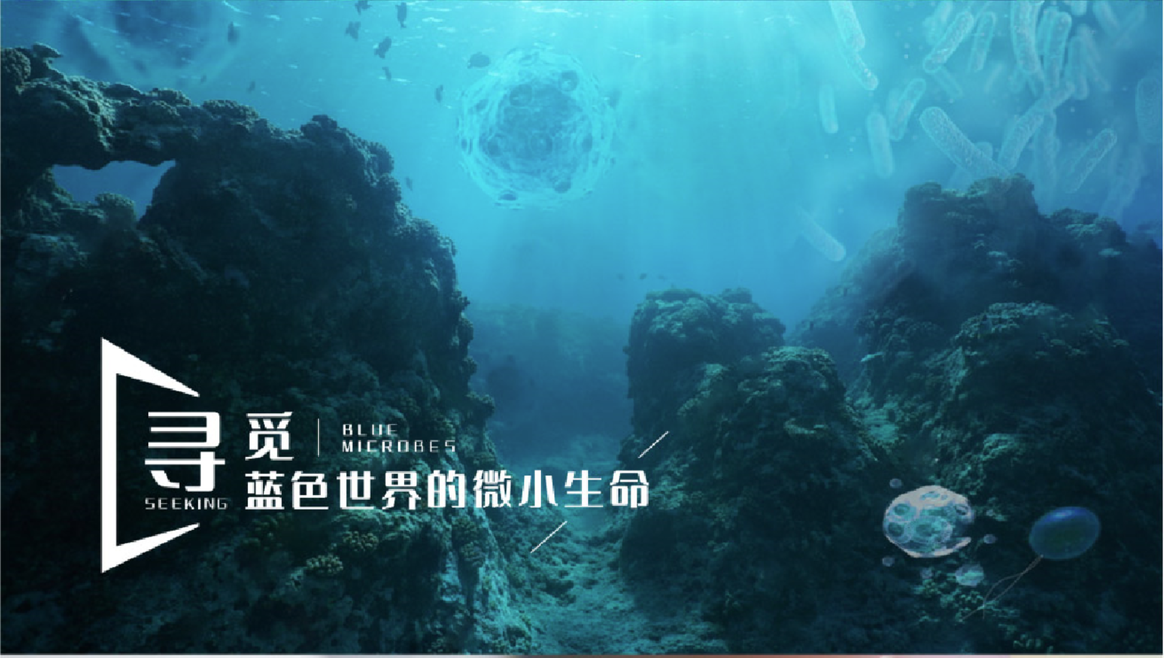
海洋微生物学及实验
2024-2025学年 秋第二周

Slide 2
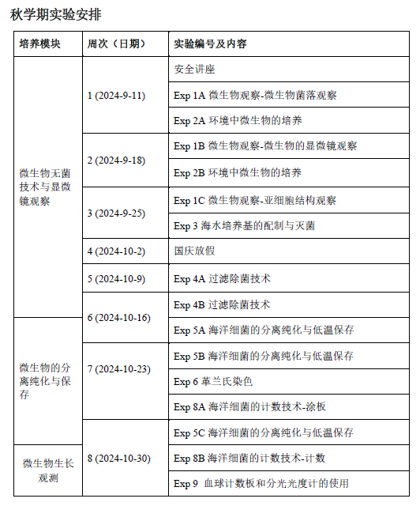
组号（共19人）
A（2人） | 魏元瀚、栾雨桐
B（2人） | 尤浩宇、柯泓宇
C（2人） | 王科缙、竺子博
D（2人）
E（2人）
F（3人） | 吴晶颖、卢宇轩、吴舒欣
G（3人） | 余东来、尹曦、刘志昂
H（3人） | 杨恬、储诗语、毛俊颖

Slide 3
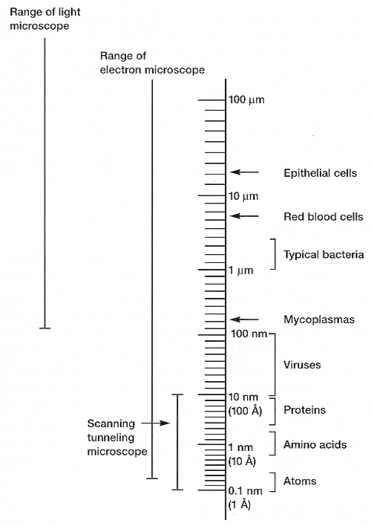
EXPERIMENT 1: Observing microorganism
微生物的观察
INTRODUCTION：
Microscopy (显微镜观察技术) is a basic, if not an essential, tool in microbiology. The light microscope has a maximum magnification of about 1000 times, giving a useful resolution of 0.2 µm.
In this experiment, you will use bright-field microscopy to examine microorganisms. Bright-field microscopy is used for the examination of both stained and unstained specimens.

Slide 4
OBJECTIVES
At the end of this experiment, you should:
Be able to describe of microorganism on plates （Exp.1A）
Be familiar with the procedures for setting up an optical microscope for bright-field microscopy （Exp.1BC）
Have a good working knowledge of the examination of microorganisms by bright-field microscopy（Exp.1BC）
EQUIPMENTS and MATERIALS
The microscope (DMBH200) （Appendix B）
Fixed slides of microorganisms (微生物制片)
Slides of the cellular structures of microorganisms （微生物细胞结构制片）

Slide 5
Appendix B: Use of the compound microscope 使用复式显微镜
The microscope will have three or four objective lenses mounted on the revolving nosepiece. In microbiology we only use the 10×, 40× and 100× objective lenses.
The lower power 10× is used with the course focus adjustment to locate the image. The 40× lens is used with the fine focus adjustment to further focus stained preparations or for final viewing of wet mounts.
The 100× lens is for oil immersion and is used to obtain the maximum magnification of a stained specimen. Oil must be used with this objective lens and no other.

Slide 6
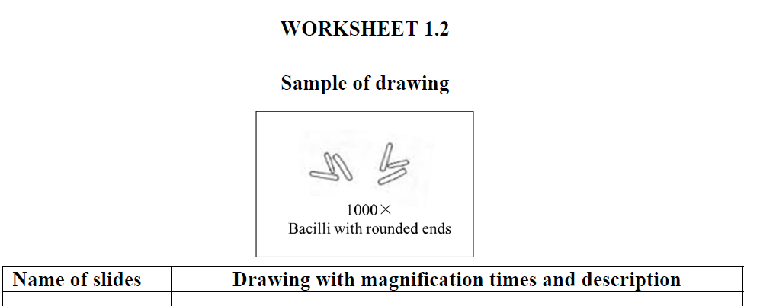
EXP 1B
METHODS
Go through the set-up procedures for bright-field microscopy using a DMBH200 Digital microscope (see Appendix B), using the provided slide to focus on.
Observe the at least 5 kinds of slides, draw and describe their cellular morphology (according to Appendix C) in worksheet 1.2.
*Appendix C: Common examples of bacterial cell morphology
放大倍数，目镜×物镜
细菌细胞的描述

Slide 7
EXPERIMENT 2: Contamination and aseptic techniques 污染与无菌技术
EXP 2B
METHODS
Examine the plates exposed to contamination in the previous laboratory period.
Record all the results from your group in Worksheet 2, and describe colonies. Descriptive features of colonies grown on solid media can be found in Appendix A.
Describe a maximum of three colony types per section (A-D).

